Slide 1

Team IGNITY
Project on the topic
"Fire safety"

Slide 2
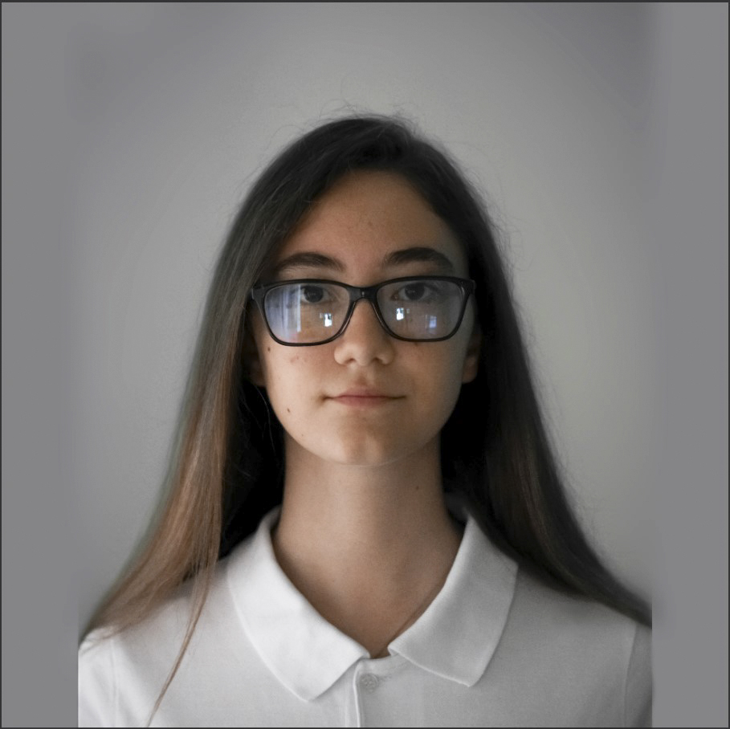
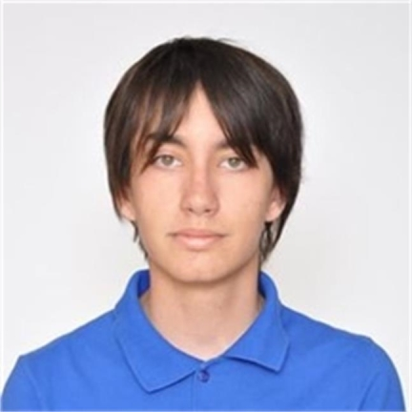
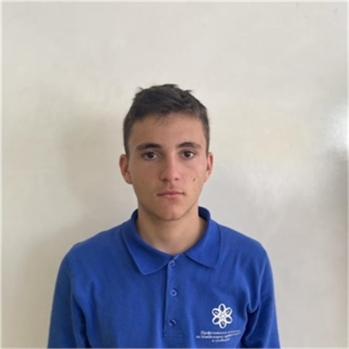
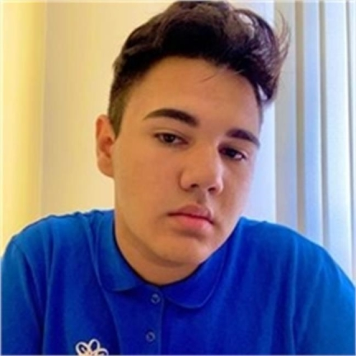
Our Team
Aleksandra Staykova
9V – Scrum trainer
Georgi Vasillev
9A – Designer
Mario Berberov
9B – Back end Developer
Veselin Stoyanov
9G – Front end Developer

Slide 3



Stages of development
1
3
2

Slide 4
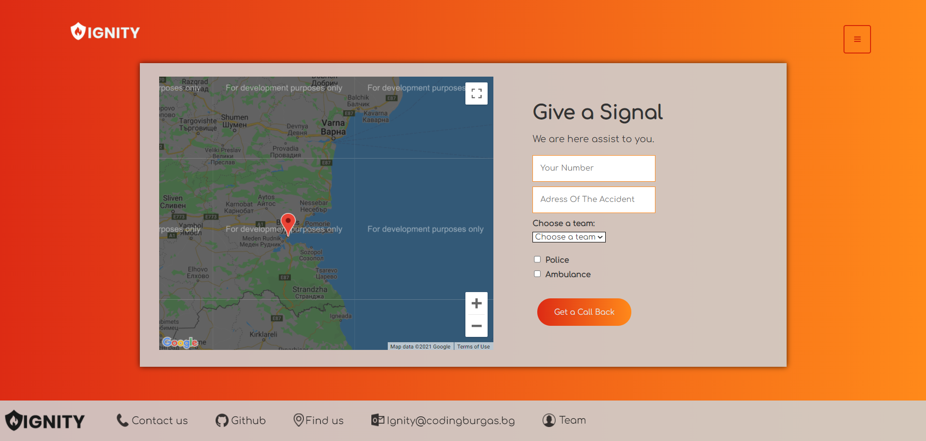
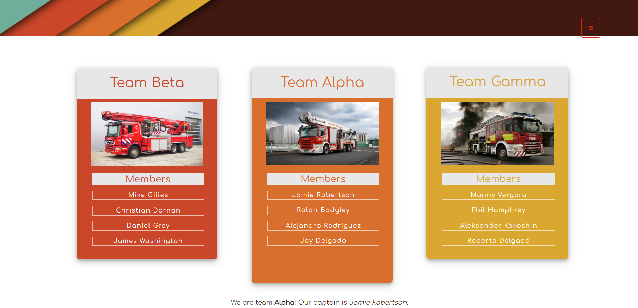
Our idea

Slide 5











The programs we used

Slide 6

Future ideas and purposes

Slide 7

Thank you for your attention

